Slide 1
Implementing Graph Mining Algorithms on GPUs based on sisa
Bachelor’s thesis
Bernard Pranjic, eth zurich

Slide 2
Executive summary
Problem and Motivation
Many problems in graph mining are NP-hard and/or have non-straightforward parallelism
More data gets digitized and data sets represented as graphs get bigger and bigger
Goal
The goal is to accelerate graph mining algorithms on GPUs and to create a CUDA based library that will solve different graph related problems efficiently
Idea
The key idea is to use a set-centric representation of graphs like in the SISA paper
Set operations like intersections can be parallelized efficiently using GPUs
Expected Results
The algorithmic speedups in SISA depend on the targeted mining algorithms
Those with an already high algorithmic speedup will most likely keep it that way
Problems where the set-centric approach in SISA was slower than hand-tuned algorithms, are expected to be faster using GPUs because of highly parallel hardware.

Slide 3
Overview
Background, Problem, Motivation and Goal
Novelty and Key Ideas
Mechanisms
Methodology and Evaluation
Expected Results
Key Contributions
Discussion

Slide 4
SISA
Maciej Besta¹, Raghavendra Kanakagiri², Grzegorz Kwasniewski¹, Rachata Ausavarungnirun³,
Jakub Beránek⁴, Konstantinos Kanellopoulos¹, Kacper Janda⁵, Zur Vonarburg-Shmaria¹, Lukas
Gianinazzi¹, Ioana Stefan¹, Juan Gómez-Luna¹, Marcin Copik¹, Lukas Kapp-Schwoerer¹, Salvatore
Di Girolamo¹, Nils Blach¹, Marek Konieczny⁵, Onur Mutlu¹, Torsten Hoefler¹
¹ETH Zurich, Switzerland ²IIT Tirupati, India ³King Mongkut’s University of Technology North Bangkok,
Thailand ⁴Technical University of Ostrava, Czech Republic ⁵AGH-UST, Poland
In MICRO-54: 54th Annual IEEE/ACM International Symposium on Microarchitecture (MICRO ’21)

Slide 5
problem and motivation
Graph mining algorithms are important for many problems in many fields of science
Well-known algorithms for these problems often do not effectively utilize parallel hardware, due to non-straightforward parallelism
Data growth requires more efficient algorithms
Good general solutions to graph mining problems can often be applied to other problems

Slide 6
goal
The goal is to accelerate graph mining algorithms on a GPU
The creation of a CUDA-based library that will solve different graph related problems efficiently

Slide 7
Overview
Background, Problem, Motivation and Goal
Novelty and Key Ideas
Mechanisms
Methodology and Evaluation
Expected Results
Key Contributions
Discussion

Slide 8
key ideas
The idea is to use set-centric formulations of graph mining algorithms like in SISA
Then implementing them on CUDA enabled GPUs
GPUs are a good fit for this problem since they offer a lot of hardware parallelism, provide large memory bandwidth and allow programmers to express irregular algorithms (e.g. dynamic parallelism)

Slide 9
novelty
Previous implementations of graph mining problems on GPUs follow vertex- or edge-centric approaches
Those are suboptimal since those algorithms often require non-local knowledge and not just neighboring vertices
SISA was the first paper to propose a set-centric approach for graph mining problems
This work will be the first to implement SISA on a GPU

Slide 10
Overview
Background, Problem, Motivation and Goal
Novelty and Key Ideas
Mechanisms
Methodology and Evaluation
Expected Results
Key Contributions
Discussion

Slide 11
mechanisms
Surveying the literature and understanding the graph mining algorithms
Understanding the SISA reference codes
Finding good baseline codes for CPU and GPU implementations to make comparisons
Implementing the SISA algorithms on the GPU and writing a CUDA-based library
Evaluating the implementations with synthetic and real datasets
Comparing the results with CPU and GPU baselines
Writing the bachelor’s thesis in the form of a research paper

Slide 12
Overview
Background, Problem, Motivation and Goal
Novelty and Key Ideas
Mechanisms
Methodology and Evaluation
Expected Results
Key Contributions
Discussion

Slide 13
Methodology (at home for development)
CPU implementations
AMD Ryzen 5800X @ 3.8 GHz
16 GB RAM
GPU implementations
NVIDIA RTX 3070 Ti
8 GB GDDR6X global memory
Memory System
16 GB RAM
8 GB GDDR6X global memory GPU

Slide 14
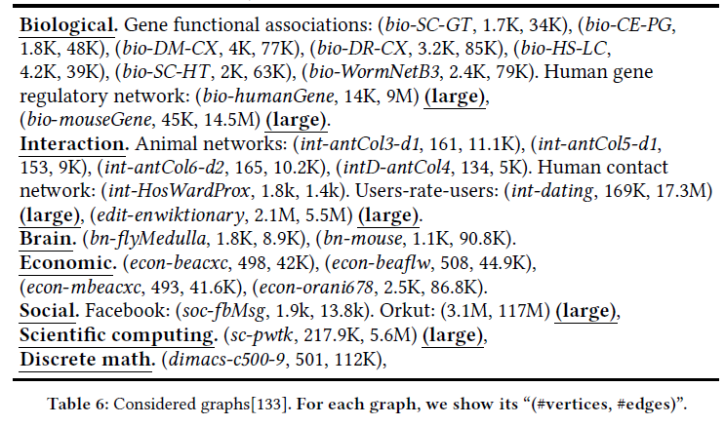
Methodology
Testing will be done using the same graphs like in SISA
NVIDIA Nsight Compute will be used for profiling runtime, memory usage and efficiency
Sparse vs. Dense Graphs
Scalability of algorithms

Slide 15
Evaluation
Well-known CPU algorithms
GPU implementations
SISA implementations
SISA+GPU implementations (this work)

Slide 16
Overview
Background, Problem, Motivation and Goal
Novelty and Key Ideas
Mechanisms
Methodology and Evaluation
Expected Results
Key Contributions
Discussion

Slide 17
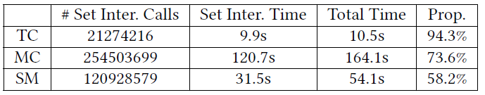
speeding up set intersections in graph algorithms using simd instructions
Shuo Han
Peking University
Lei Zou
Peking University
Jeffery Xu Yu
The Chinese University of Hong Kong
In Proceedings of the 2018 International Conference on Management of Data. ACM, 1587–1602.
https://dl.acm.org/doi/10.1145/3183713.3196924

Slide 18
expected results
Algorithmic vs. Architectural speedup in SISA depends on the targeted graph mining algorithm
Those algorithms with a high algorithmic speedup will most likely keep it that way
A problem like triangle counting, that is slower in SISA, has a high percentage of set operations (up to 94% of the runtime), so a set-centric GPU implementation can greatly improve the runtime.

Slide 19
first attempt at set operations
About 4x speedup for set intersection, union and complement
About 60x speedup for triangle counting (no code comparison yet)

Slide 20
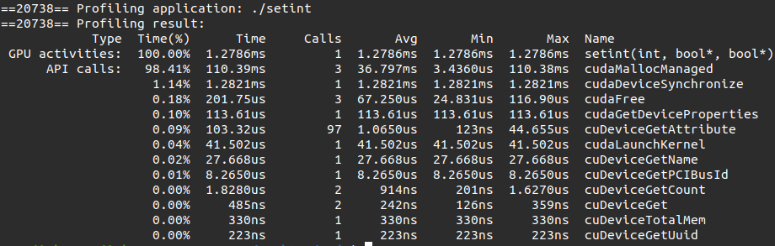
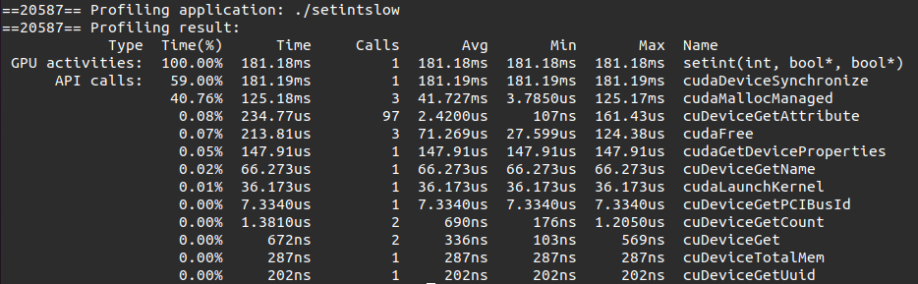
set intersection

Slide 21
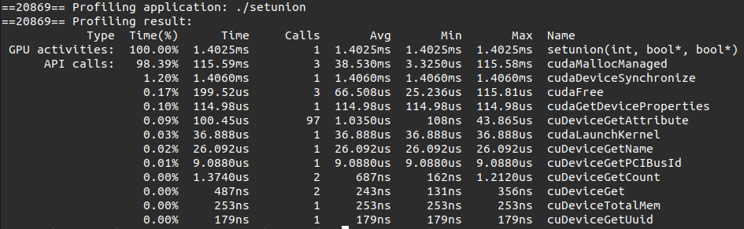
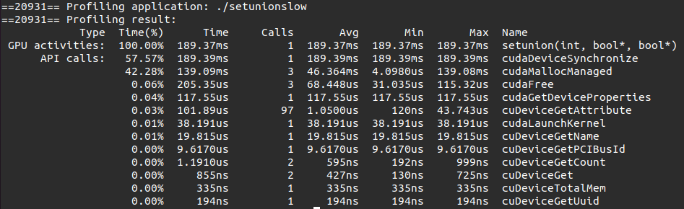
set union

Slide 22
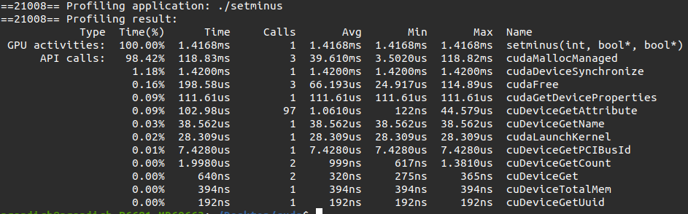
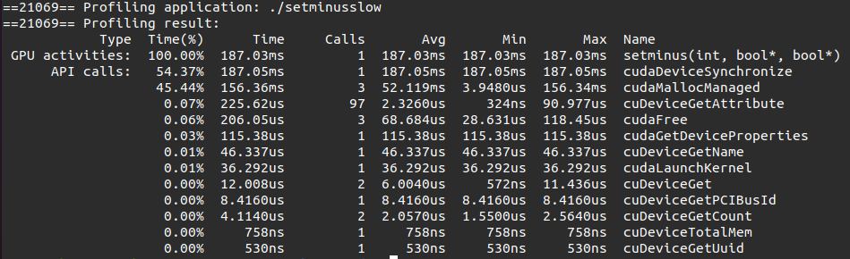
set complement

Slide 23
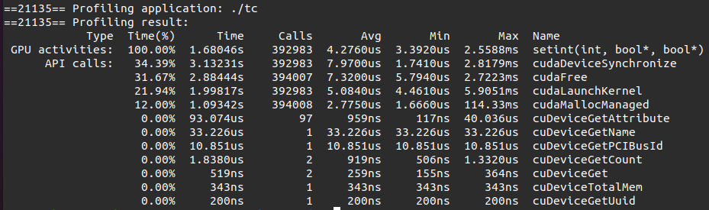
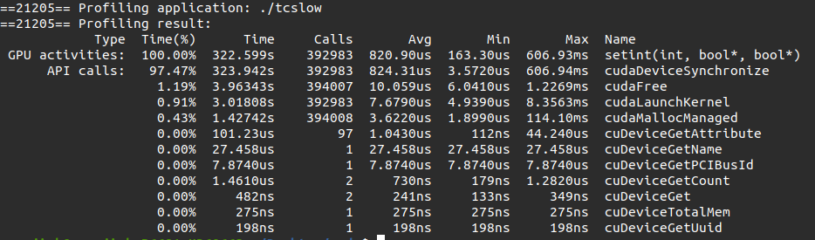
Triangle counting

Slide 24
code demo

Slide 25
Overview
Background, Problem, Motivation and Goal
Novelty and Key Ideas
Mechanisms
Methodology and Evaluation
Expected Results
Key Contributions
Discussion

Slide 26
key contributions
This work will show that GPUs are a good fit for the SISA framework
This work will be the first to implement the set-centric graph mining algorithms presented in SISA on GPUs
This work will create an open-source CUDA-based library with programmer’s friendly implementations of graph mining algorithms
a high-quality paper publishable at a top venue

Slide 27
Overview
Background, Problem, Motivation and Goal
Novelty and Key Ideas
Mechanisms
Methodology and Evaluation
Expected Results
Key Contributions
Discussion

Slide 28
discussion
Suggestions?
Possible use cases
Processing-In-Memory?

Slide 29
Related works
SISA
Pangolin
Peregrine
FlexMiner
TrieJax
IntersectX

Slide 30
Pangolin
Xuhao Chen, Roshan Dathathri, Gurbinder Gill, Keshav Pingal
University of Texas at Austin
Graph pattern mining system on shared memory CPUs and GPUs
Allows the user to specify eager enumeration search space pruning and customized pattern classification

Slide 31
peregrine
Kasra Jamshidi, Rakesh Mahadasa, Keval Vora
School of Computing Science, Simon Fraser University
A pattern-aware graph mining system
It tries to improve graph pattern algorithms by avoiding the exploration of unnecessary subgraphs

Slide 32
flexminer
Xuhao Chen, Tianhao Huang, Shuotao Xu, Thomas Bourgeat, Chanwoo Chung, Arvind
Massachusetts Institute of Technology
Hardware/Software graph pattern mining accelerator
Together with Pangolin, the codes are implemented in GraphMiner
These codes will also be used as GPU baselines

Slide 33
Triejax
Oren Kalinsky, Benny Kimelfeld, Yoav Etsion
Technion-Israel Institute of Technology
Hardware accelerator for graph pattern matching algorithms
Based on relational joins

Slide 34
intersectx
Gengyu Rao, Jingji Chen, Jason Yik, Xuehai Qian
University of Southern California
Hardware accelerator for graph mining

